Slide 1
Team All G
Week 8 Presentation
Isabel Barlow, Ryan Klugman, Bowei Liu

Slide 2
Progress in Week 7
Began working on Flash Memory
Designed webapp layout
Began working on ultrasonic sensor
Current status: computer sends music and it plays

Slide 3
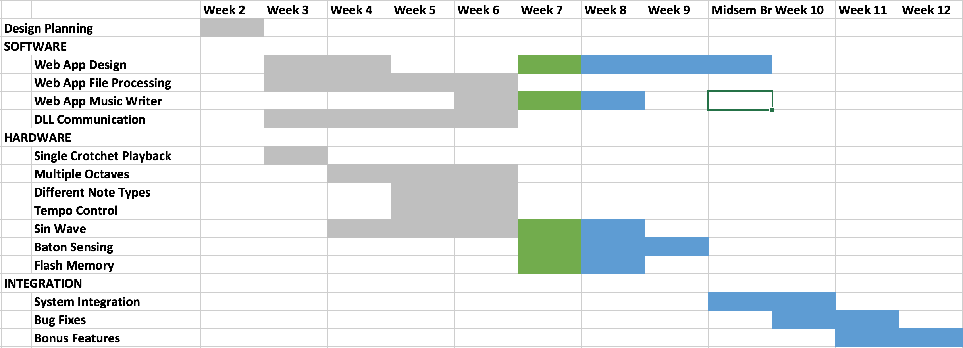
GANTT Chart

Slide 4
Flash Memory
Can Read/Write to Flash
How we will use it:
Download over EPP into a buffer in RAM
Load from buffer into Flash

Slide 5
Webapp design
Two options for input: keyboard or buttons
Compromise: use both

Slide 6
Week 8
Implement Web design
Sine waves
Continue working on ultrasonic sensor
Integrate Flash Memory usage

Slide 7
Questions?

